Slide 1
Pre-trained
meaning representations
for text data
( Embeddings 2. Applications )
Ana Sabina Uban, Lect dr. https://nlp.unibuc.ro/people/anauban.html
Facultatea de Matematică și Informatică
Universitatea din București
iulie 2024

Slide 2
Presentation Overview
Pre-trained embeddings and applications beyond text classification: semantic similarity and the word vector space
Beyond static embeddings: contextual embeddings with transformers
Practical examples!
A peek into semantic representations beyond words: sentence embeddings - and applications

Slide 3
Let’s move on to learning through practice…
https://colab.research.google.com/drive/1YhI81JG-Qi-9U17R3Lp36iNAJOpU65zp?usp=sharing

Slide 4
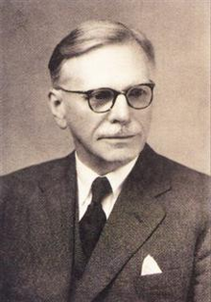
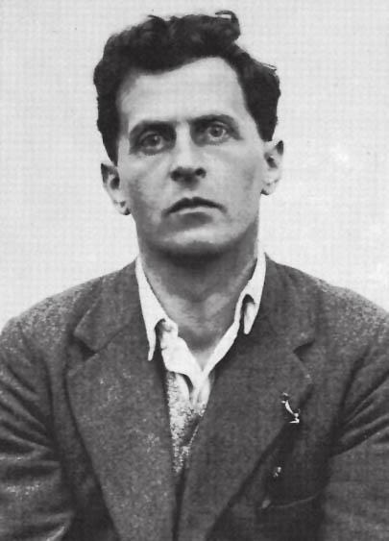
Word embeddings: word vectors via distributional
similarity-based representations
Idea: representing a word
by means of its neighbors / context
“You shall know a word by the company it keeps”
(J. R. Firth, 1957)
Philosophy: Ludwig Wittgenstein
“The meaning of a word is defined by the way it is used”

Slide 5
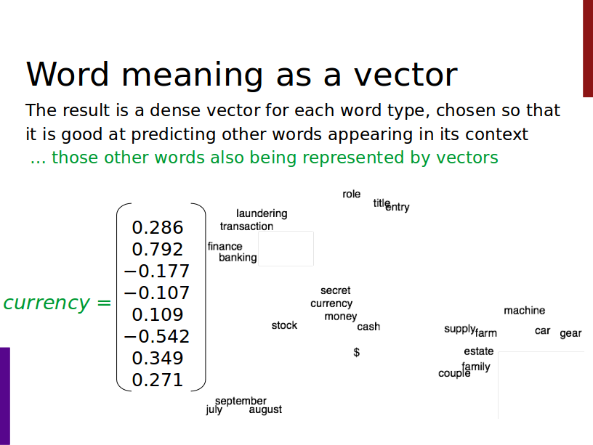

Slide 6
Sparse versus dense vectors
Why dense vectors?
Short vectors may be easier to use as features in machine learning (fewer weights to tune)
Dense vectors may generalize better than storing explicit counts
They may do better at capturing synonymy:
car and automobile are synonyms; but are distinct dimensions
+ other semantic relationships (e.g. analogies)
In practice, they work better
‹#›

Slide 7
Properties of embeddings
Results depend on:
the corpus used for training the embeddings - size, domain: pre-trained embeddings should ideally be in a similar register to your data; with enough data you can also train your own representations
their dimensionality (50/100/300/…) - the larger the more refined (given enough training data!)
‹#›

Slide 8
Properties of embeddings
Similarity depends on window size C
C = ±2 The nearest words to Hogwarts:
Sunnydale
Evernight
C = ±5 The nearest words to Hogwarts:
Dumbledore
Malfoy
halfblood
‹#›

Slide 9




Pre-trained embeddings you can download!
Word2vec (Mikolov et al., 2013)
https://code.google.com/archive/p/word2vec/
Fasttext http://www.fasttext.cc/ (sub-word information)
Glove (Pennington, Socher, Manning, 2014)
http://nlp.stanford.edu/projects/glove/
Embeddings improve everything!
(across NLP tasks)

Slide 10
Pre-trained embeddings you can download!
Romanian (& many more languages):
https://fasttext.cc/docs/en/pretrained-vectors.html

Slide 11
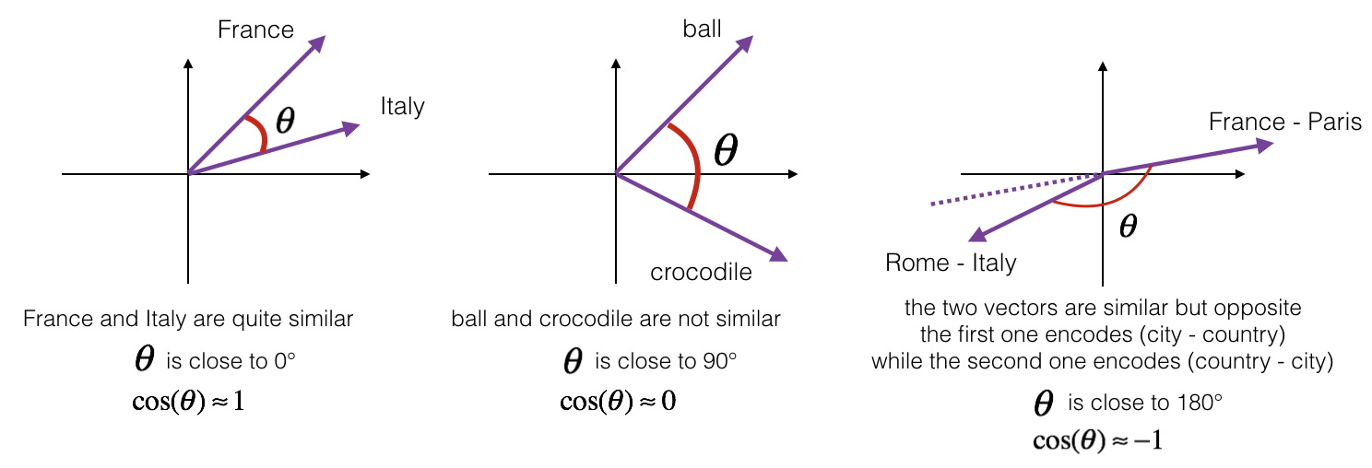
Word similarity: cosine distance/similarity

Slide 12
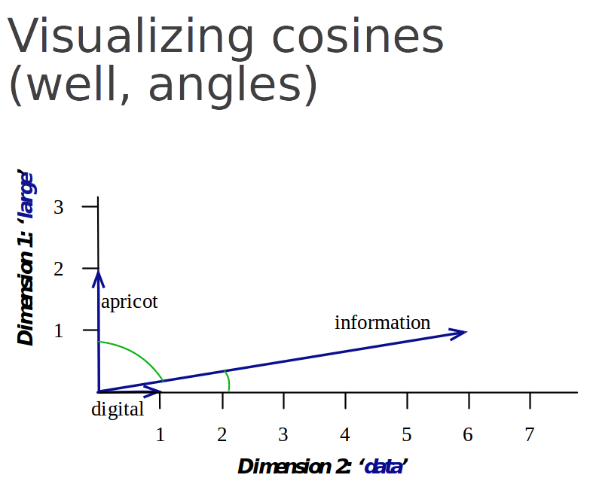
A small detour into distances in different vector spaces

Slide 13
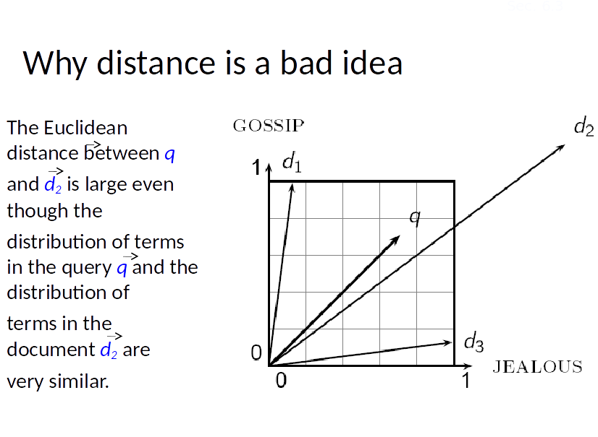

Slide 14
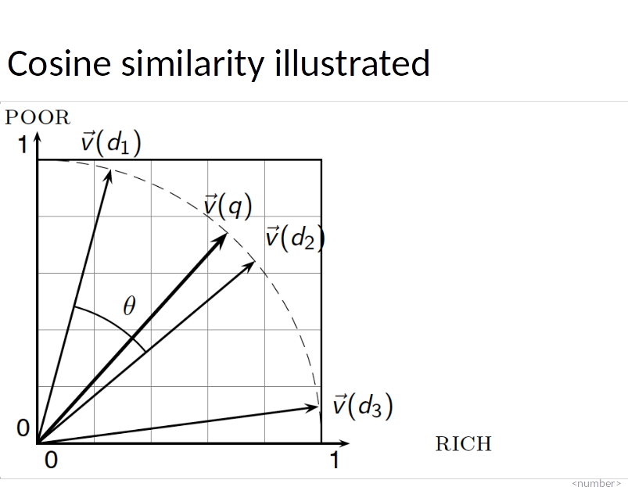

Slide 15
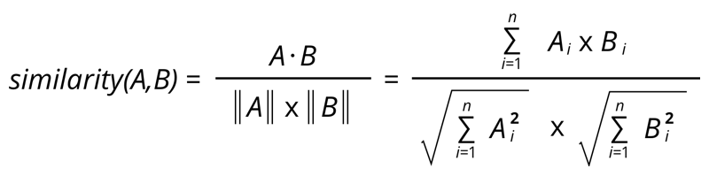
Word similarity: cosine distance/similarity

Slide 16
Evaluating embeddings
Intrinsic:
Compare to human scores on word similarity-type tasks:
WordSim-353 (Finkelstein et al., 2002)
SimLex-999 (Hill et al., 2015)
Stanford Contextual Word Similarity (SCWS) dataset (Huang et al., 2012)
TOEFL dataset: Levied is closest in meaning to: imposed, believed, requested, correlated

Slide 17
Visualizing embeddings
https://projector.tensorflow.org/

Slide 18
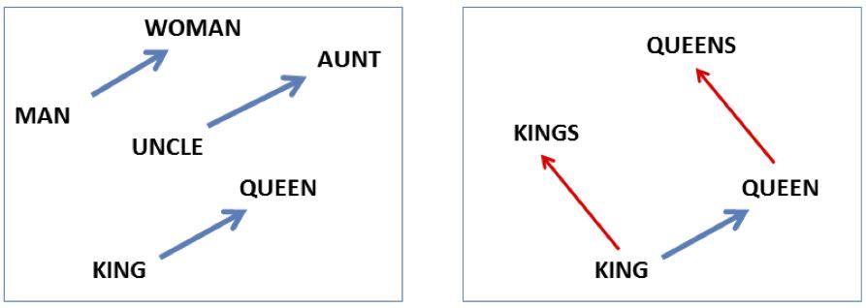
Analogy: Embeddings capture relational meaning!
vector(‘king’) - vector(‘man’) + vector(‘woman’) ~ vector(‘queen’)
vector(‘Paris’) - vector(‘France’) + vector(‘Italy’) ~ vector(‘Rome’)
‹#›

Slide 19
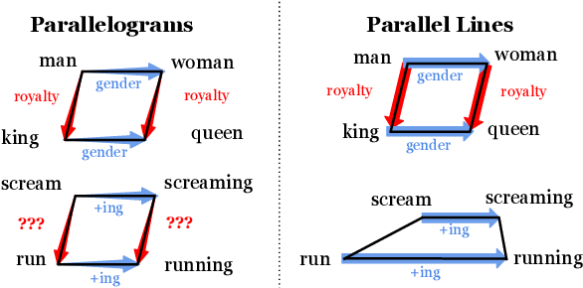
Analogy: Embeddings capture relational meaning!
Narutatsu Ri, Fei-Tzin Lee, and Nakul Verma. 2023. Contrastive Loss is All You Need to Recover Analogies as Parallel Lines. In Proceedings of the 8th Workshop on Representation Learning for NLP (RepL4NLP 2023), pages 164–173, Toronto, Canada. Association for Computational Linguistics.
‹#›

Slide 20
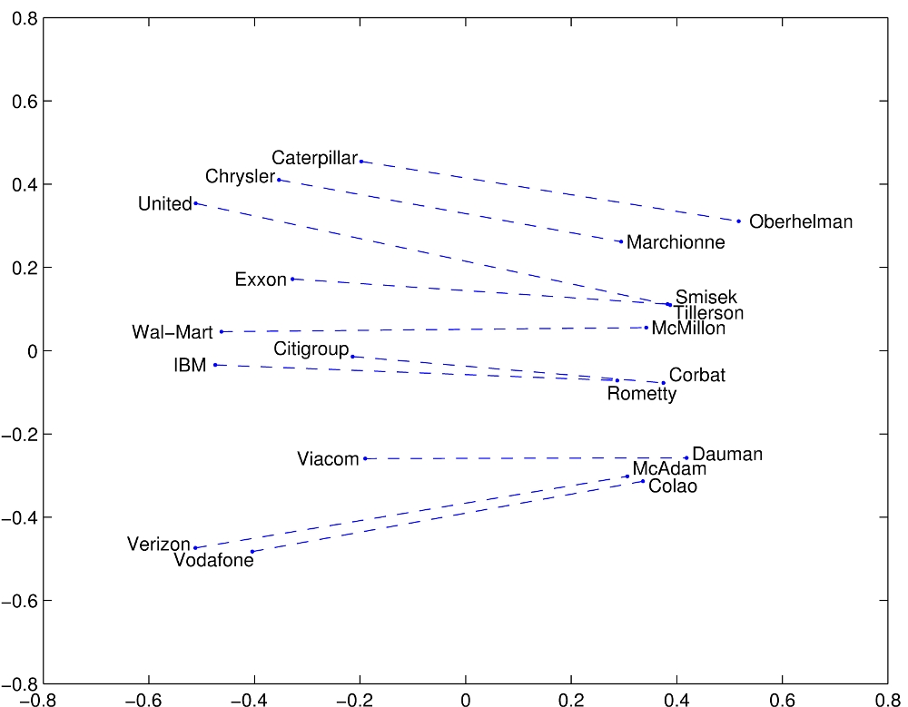
GloVe visualizations: company-CEO
https://nlp.stanford.edu/projects/glove/

Slide 21
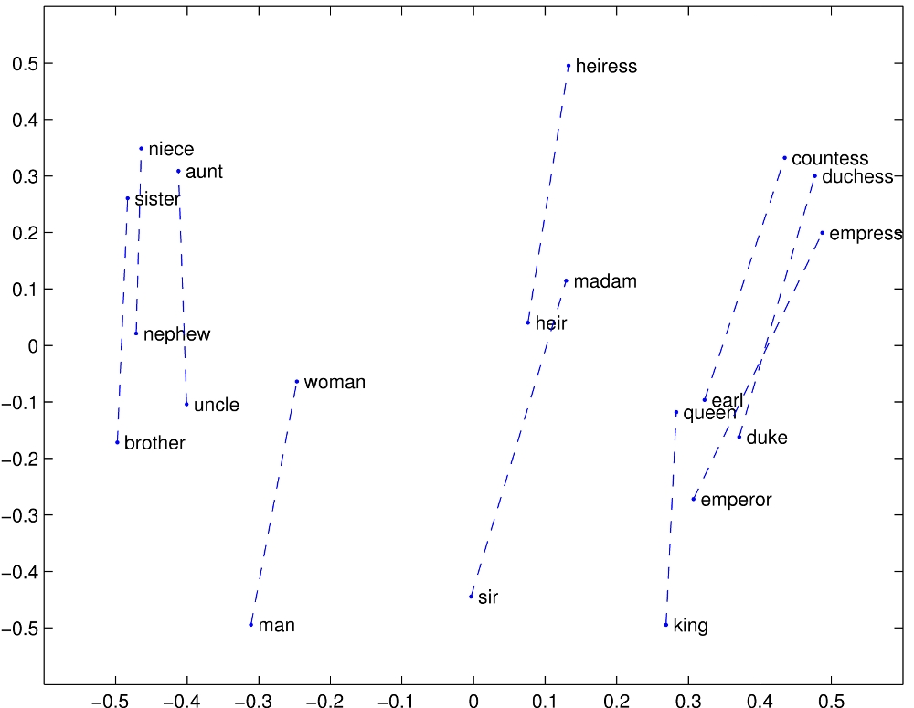
GloVe visualizations: gender pairs

Slide 22
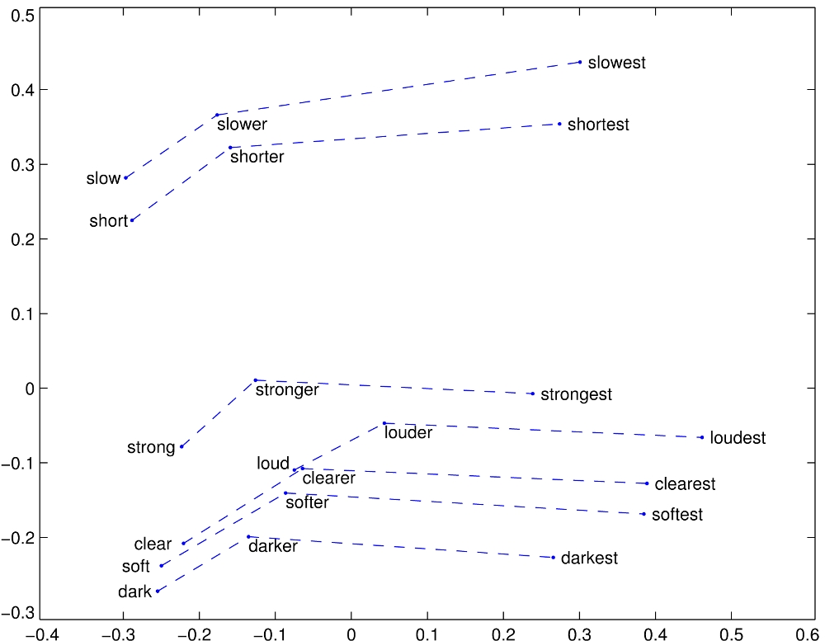
GloVe visualizations: morphological relationships

Slide 23
Embeddings applications
Word Similarity
Any NLP application with a semantic component…?:
Machine Translation
Part-of-Speech and Named Entity Recognition
Sentiment Analysis
Semantic Analysis of Documents
Build word distributions for various topics, etc.
Text classification, other ML models… (input to classifiers - use pretrained embeddings out-of-the-box / fine tune them)
Linguistics & other applications:

Slide 24
Embeddings can help study word history!
Train embeddings on old books to study changes in word meaning!
Idea: train embeddings on two different corpora; compare
Other applications: compare word connotations in different domains, dialects

Slide 25




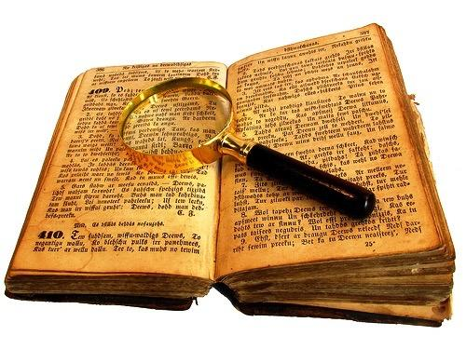

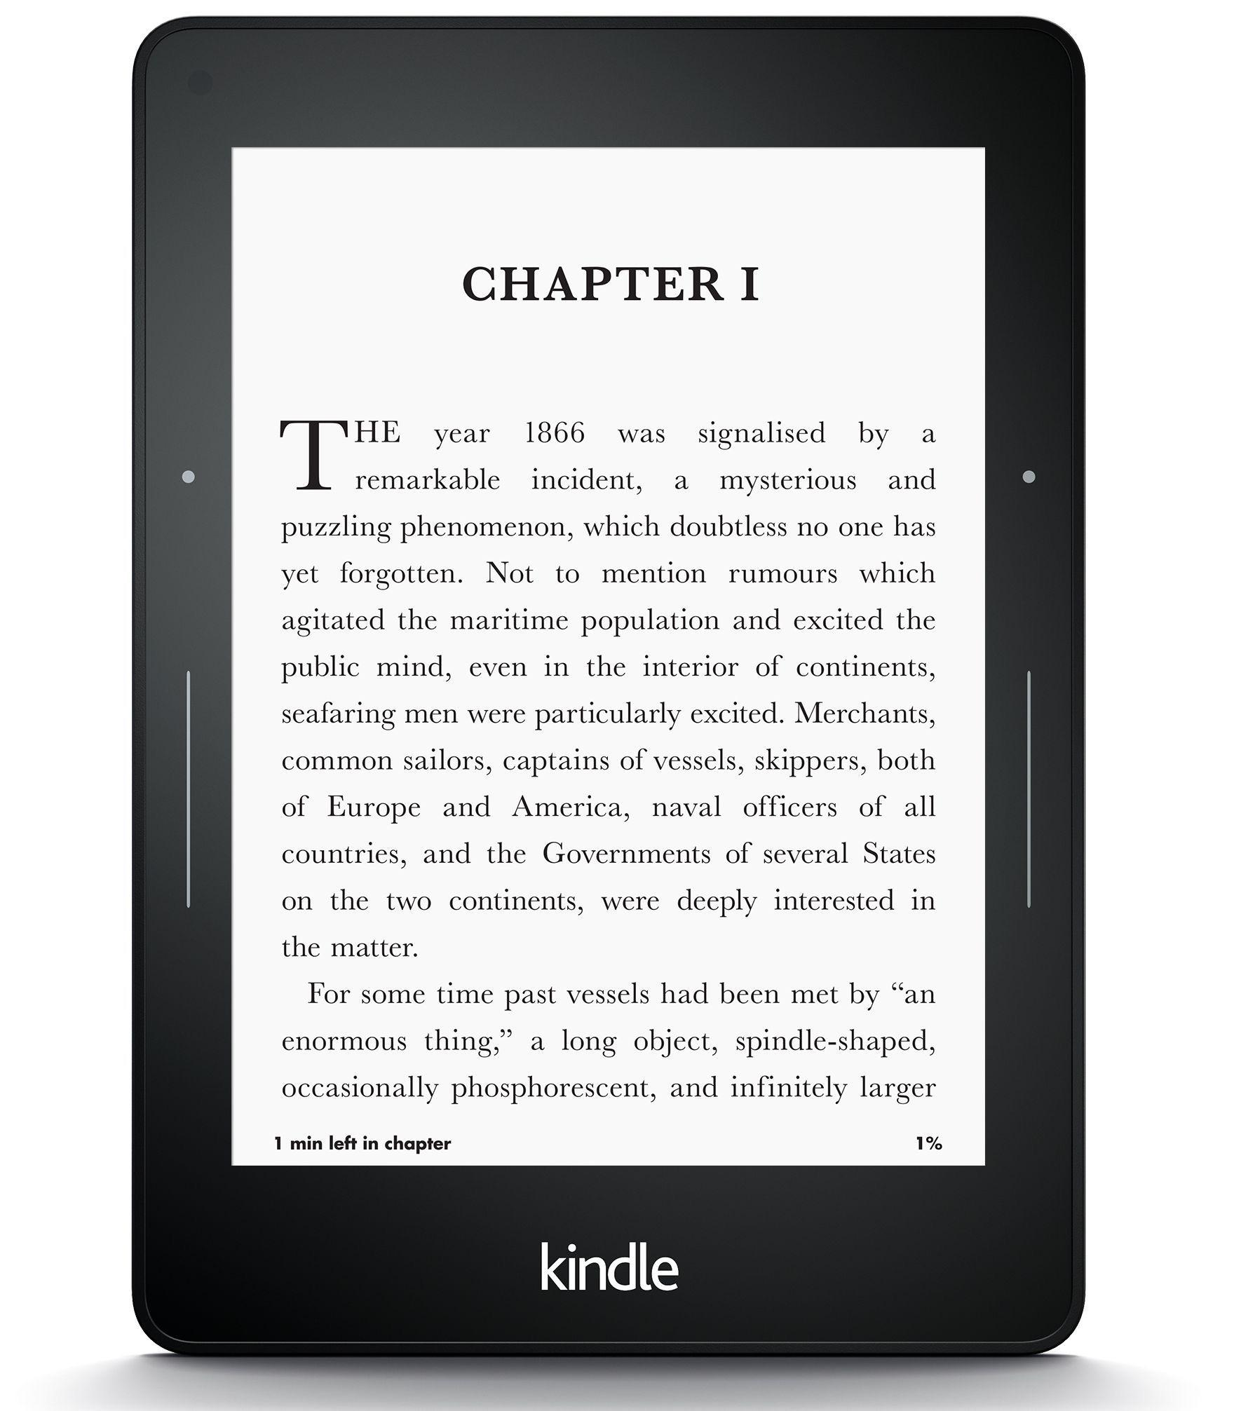
Diachronic word embeddings for studying language change!
Word vectors for 1920
Word vectors 1990
“dog” 1990 word vector
“dog” 1920 word vector
vs.
1900
1950
2000
￼
￼
William L. Hamilton, Jure Leskovec, and Dan Jurafsky. 2016. Diachronic Word Embeddings Reveal Statistical Laws of Semantic Change. In Proceedings of the 54th Annual Meeting of the Association for Computational Linguistics (Volume 1: Long Papers), pages 1489–1501, Berlin, Germany. Association for Computational Linguistics.
‹#›

Slide 26
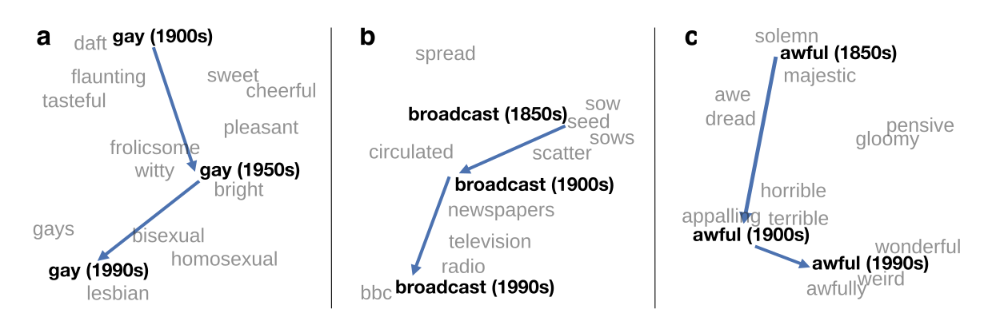
Visualizing changes
Project 300 dimensions down into 2
~30 million books, 1850-1990, Google Books data

Slide 27
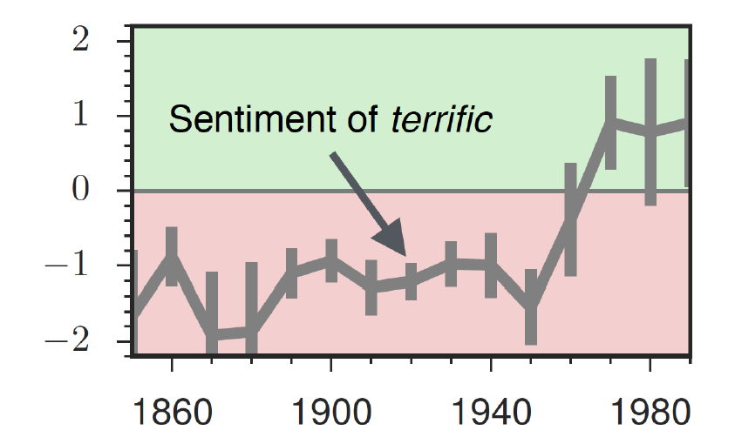
The evolution of sentiment words
Negative words change faster than positive words
William L. Hamilton, Kevin Clark, Jure Leskovec, and Dan Jurafsky. 2016. Inducing Domain-Specific Sentiment Lexicons from Unlabeled Corpora. In Proceedings of the 2016 Conference on Empirical Methods in Natural Language Processing, pages 595–605, Austin, Texas. Association for Computational Linguistics.
‹#›

Slide 28
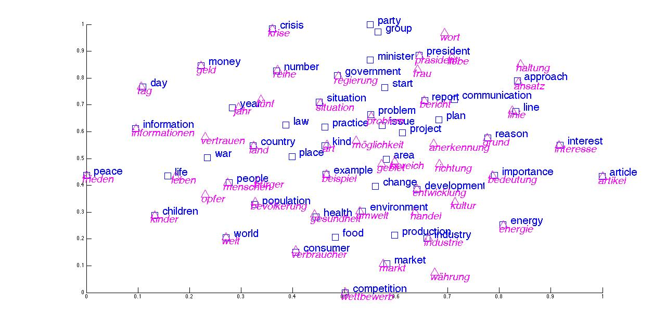
Multilingual embeddings

Slide 29
Multilingual embeddings
Disclaimer!
In order to obtain a "combined" embedding space, a special "alignment" operation is needed after training each embedding space separately (English embeddings, Spanish embeddings, Romanian embeddings etc).
We cannot take separately trained embedding spaces and compare them directly (even if they were in the same language), because the positions of words in the embedding space is not guaranteed / stable across training sessions (only their relative positions/distances are).
The same stands for any of the seen applications which compare different embedding spaces.
Still… what could we do instead to compare embedding spaces without alignment?

Slide 30
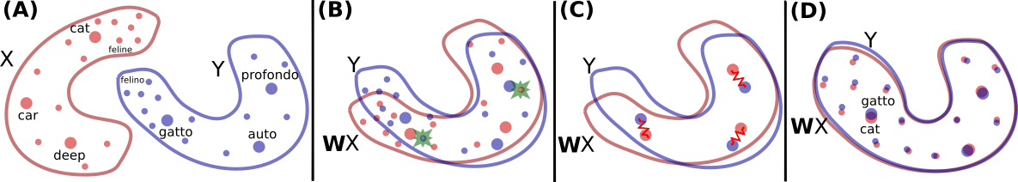
Multilingual embeddings
Can be learned in an unsupervised way, through alignment of monolingual spaces - usually finding an optimal linear transformation.
https://github.com/facebookresearch/MUSE

Slide 31
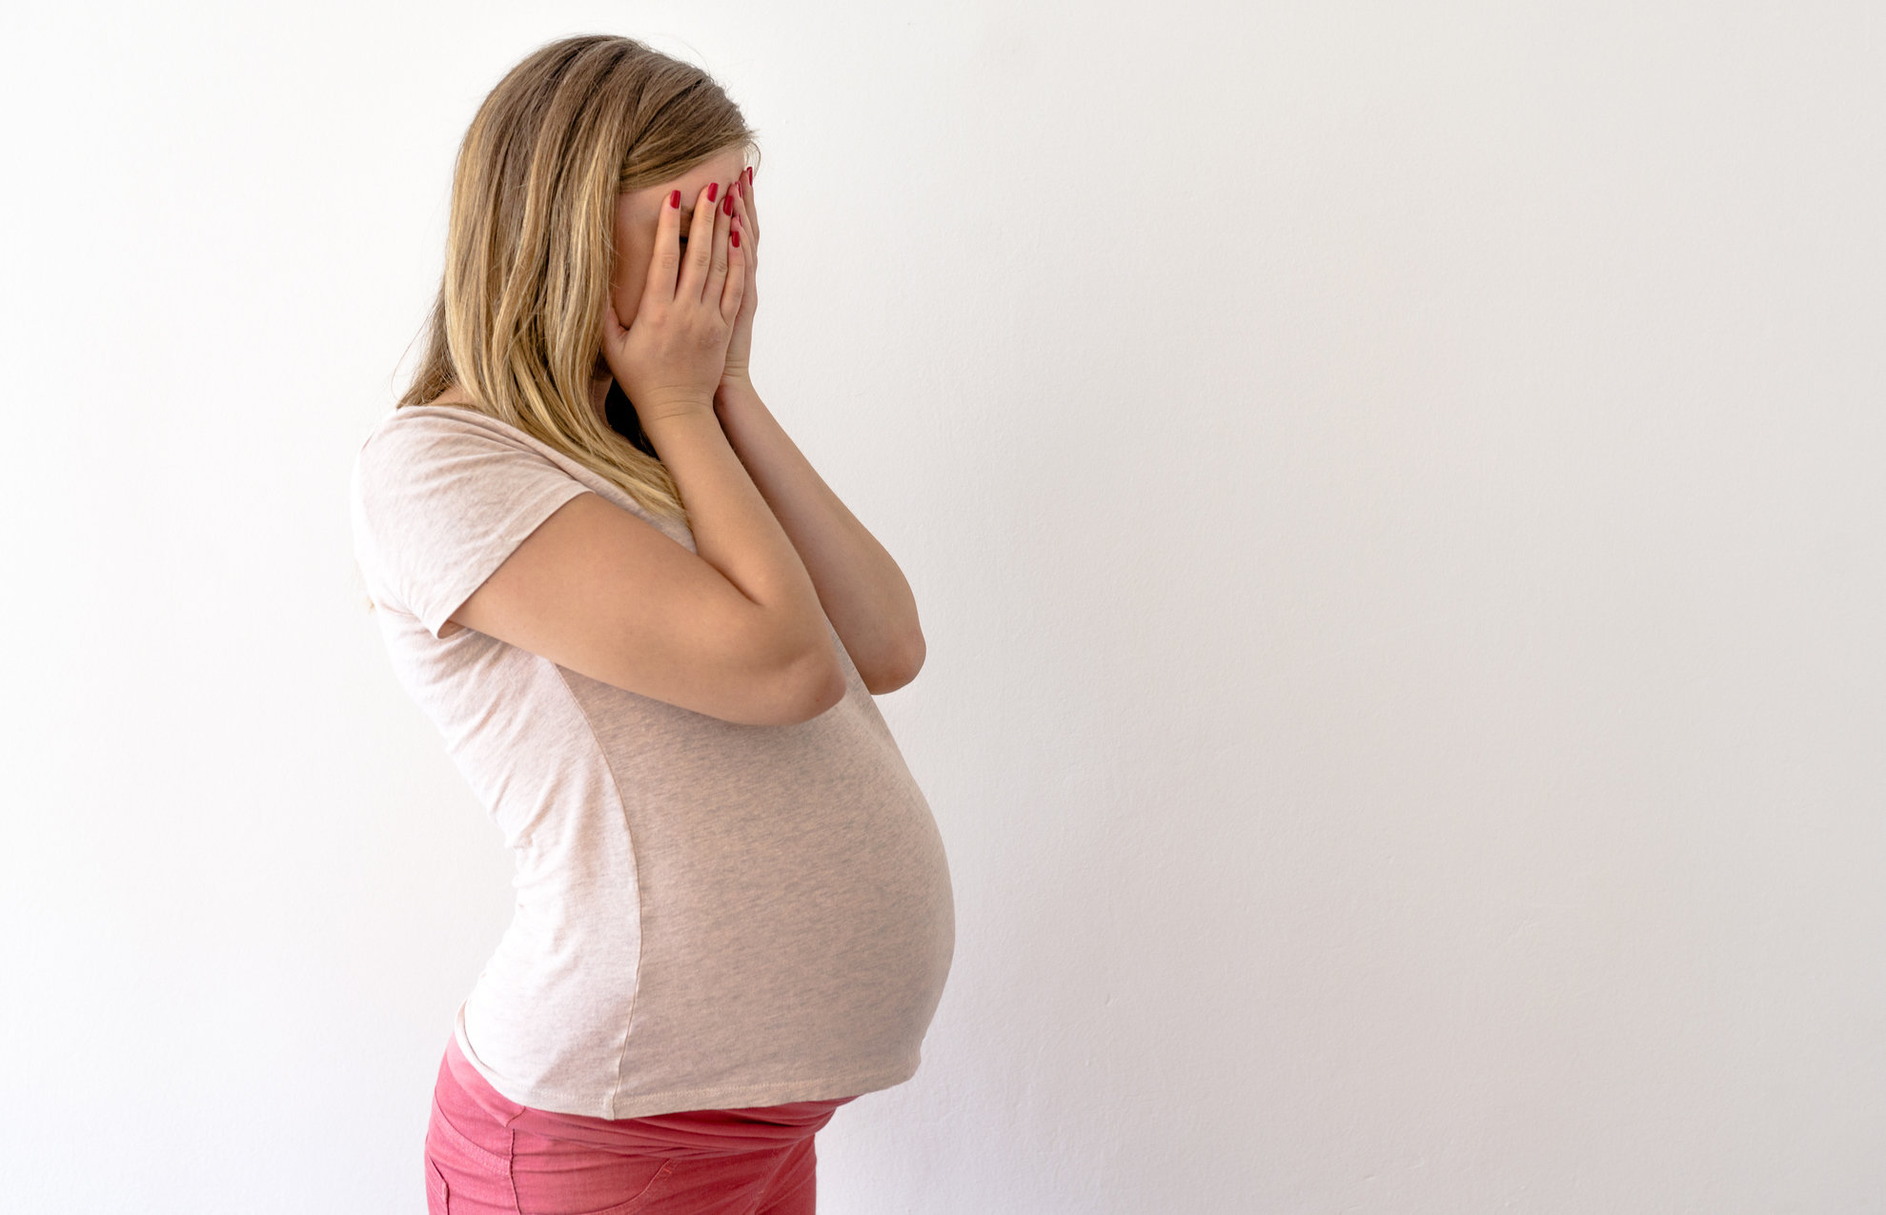
Multilingual embeddings
We can use multilingual embeddings to detect false friends!
https://github.com/ananana/false_friends_resource
embarazada … embarrassed ?? (practical example soon)

Slide 32
History of biased framings of women
Garg, Nikhil, Schiebinger, Londa, Jurafsky, Dan, and Zou, James (2018). Word embeddings quantify 100 years of gender and ethnic stereotypes. Proceedings of the National Academy of Sciences, 115(16), E3635–E3644
Embeddings for competence adjectives are biased toward men
Smart, wise, brilliant, intelligent, resourceful, thoughtful, logical, etc.
This bias is slowly decreasing

Slide 33
Embeddings reflect cultural bias
Bolukbasi, Tolga, Kai-Wei Chang, James Y. Zou, Venkatesh Saligrama, and Adam T. Kalai. "Man is to computer programmer as woman is to homemaker? debiasing word embeddings." In Advances in Neural Information Processing Systems, pp. 4349-4357. 2016.
Ask “Paris : France :: Tokyo : x”
x = Japan
Ask “father : doctor :: mother : x”
x = nurse
Ask “man : computer programmer :: woman : x”
x = homemaker

Slide 34
Embeddings as a window onto history
Garg, Nikhil, Schiebinger, Londa, Jurafsky, Dan, and Zou, James (2018). Word embeddings quantify 100 years of gender and ethnic stereotypes. Proceedings of the National Academy of Sciences, 115(16), E3635–E3644
Use the Hamilton historical embeddings
The cosine similarity of embeddings for decade X for occupations (like teacher) to male vs female names
Is correlated with the actual percentage of women teachers in decade X

Slide 35
Embeddings reflect ethnic stereotypes over time
Garg, Nikhil, Schiebinger, Londa, Jurafsky, Dan, and Zou, James (2018). Word embeddings quantify 100 years of gender and ethnic stereotypes. Proceedings of the National Academy of Sciences, 115(16), E3635–E3644
Princeton trilogy experiments
Attitudes toward ethnic groups (1933, 1951, 1969) scores for adjectives
industrious, superstitious, nationalistic, etc
Cosine of Chinese name embeddings with those adjective embeddings correlates with human ratings.

Slide 36
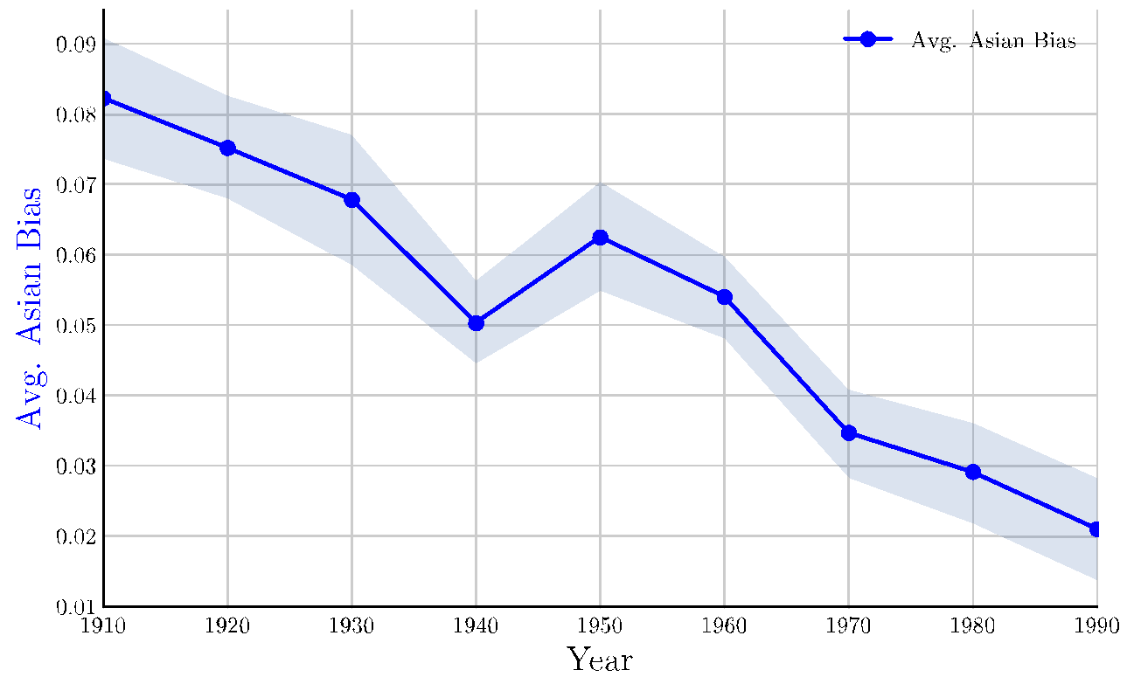
Change in linguistic framing 1910-1990
Garg, Nikhil, Schiebinger, Londa, Jurafsky, Dan, and Zou, James (2018). Word embeddings quantify 100 years of gender and ethnic stereotypes. Proceedings of the National Academy of Sciences, 115(16), E3635–E3644
Change in association of Chinese names with adjectives framed as "othering" (barbaric, monstrous, bizarre)

Slide 37
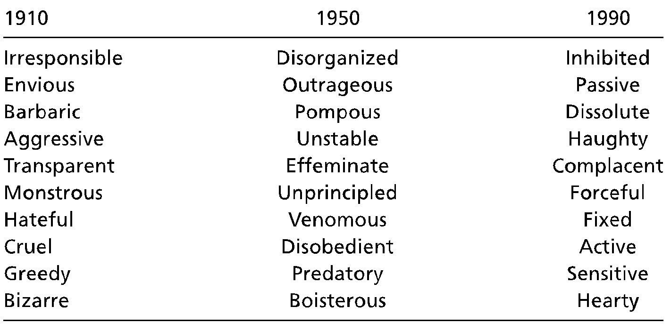
Changes in framing: adjectives associated with Chinese
Garg, Nikhil, Schiebinger, Londa, Jurafsky, Dan, and Zou, James (2018). Word embeddings quantify 100 years of gender and ethnic stereotypes. Proceedings of the National Academy of Sciences, 115(16), E3635–E3644

Slide 38
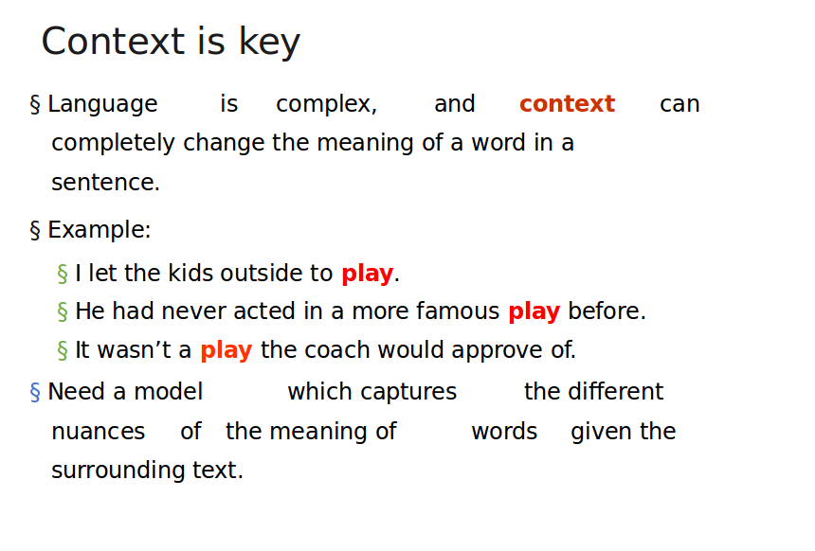

Slide 39


Beyond word2vec:
Contextual embeddings
ELMo: Embeddings from Language Models Representations
Peters, Matthew E., Mark Neumann, Mohit Iyyer, Matt Gardner, Christopher Clark, Kenton Lee, and Luke Zettlemoyer. "Deep contextualized word representations."
BERT
J.Devlin, M. Chang, K. Lee and K. Toutanova, BERT: Pre-training of Deep Bidirectional Transformers for Language Understanding (2018)
ChatGPT, Llama, Mistral, ……

Slide 40
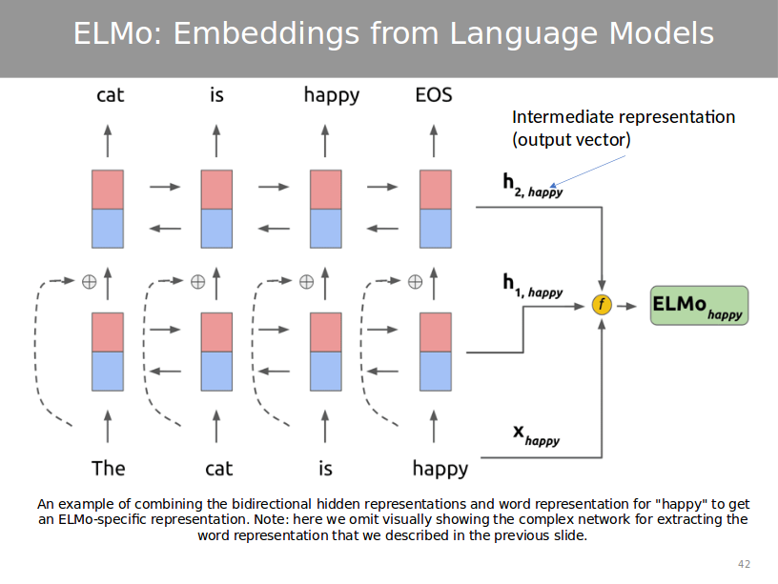

Slide 41
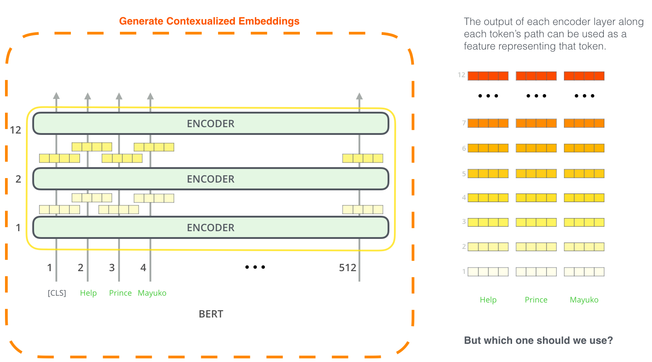
Transformers & contextual embeddings

Slide 42
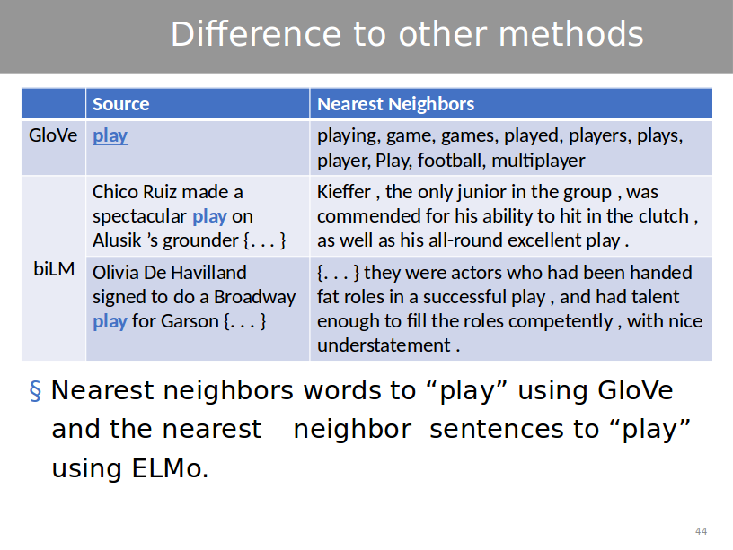
BERT
BERT

Slide 43
Let’s move on to learning through practice…
https://colab.research.google.com/drive/1YhI81JG-Qi-9U17R3Lp36iNAJOpU65zp?usp=sharing

